Slide 1
Panda Mall
Advisor: Mr Razi-ud-din
Asjad Iftikhar 18L-0951
M. Zain Arshad 18L-1109
Tayyab Waseem 18L-1017

Slide 2
Table of contents
Quick Recap
01
Overview of Project and Recap
Demo: Store/Admin
02
Management, Dashboard
Model Overview
03
Integration
Demo: Customer
04
Implementation and results
Conclusion
05
New Beginnings

Slide 3
Panda Mall
A Website based on Machine Learning recommendation system for online shopping.
Hundreds of online shopping stores
Covid 19 pandemic restrictions
But why?

Slide 4
Recap
FYP - 1:
Data Collection
Model Training
Results and Analysis
FYP - 2 Mid:
Front End Static
Base: Customer, Store, Admin Panels
…More on these later!

Slide 5
Demo: Store/Admin
Store
Admin
Dashboard

Slide 6
DataSet
Total Ratings 10183
Total Users 1025
Total Products 922 (Diners,Uniworth,The Shop.pk)
1025 Users Have Randomly Rated Products
Sources (Google Form 40% Data, Stores Websites 60%)
Used EDA Techniques For Data Cleaning

Slide 7
Algorithm Selection
Naive Approach (Control)
Decision Tree
Content Based Filtering
Collaborative Filtering
User-to-User
Item-to-User

Slide 8
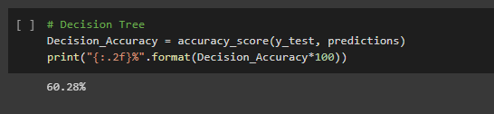
Decision Tree
Insatiable for Data Changes
More Depth More Time For Training
Inadequate for Predicting Continuous Data

Slide 9
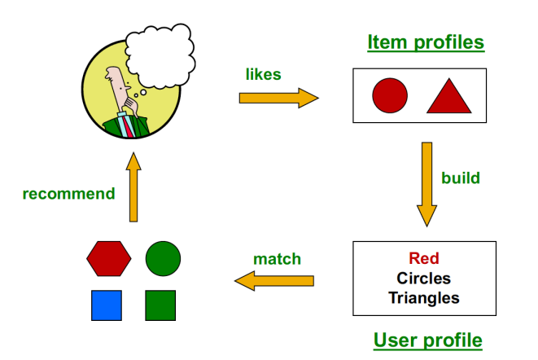
COntent-BAsed Filtering

Slide 10
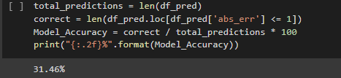
Content-Based
Finding appropriate features is hard
New User Profiling is not easy
Never recommends outside user’s content profile

Slide 11
User vs Item Based
In theory, user-user and item-item are dual approaches
In practice, item-item outperforms user-user in many cases
Items are simpler than user
Items belongs to a small set of ‘Genres’,users have varied tastes.
Item Similarity is more meaningful than User Similarity

Slide 12
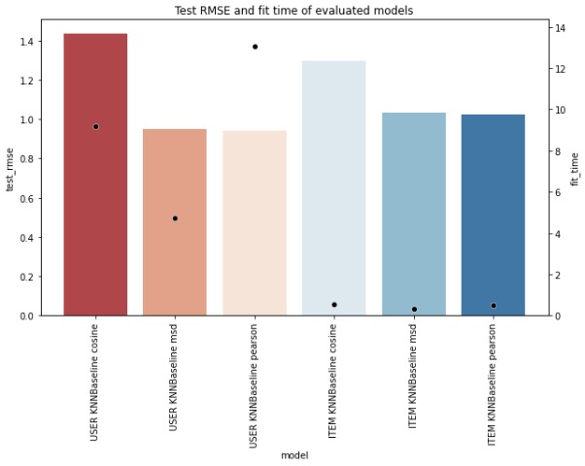
User vs Item Based

Slide 13
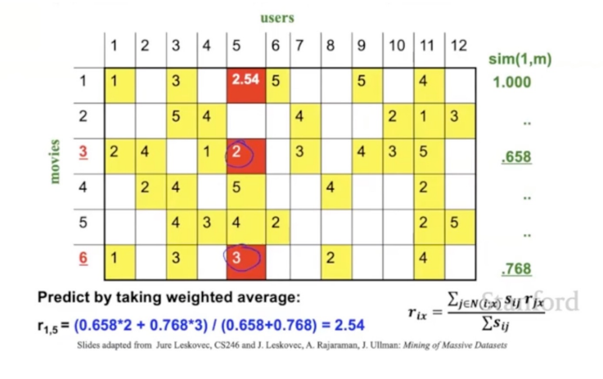
User vs Item Based

Slide 14
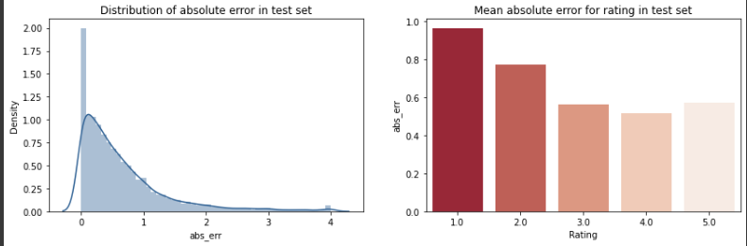
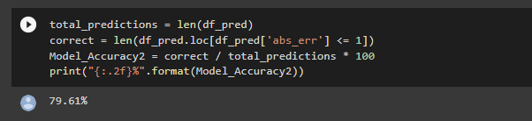
User vs Item Based

Slide 15
Demo: Customer
Customer Front End Panel
Recommendations

Slide 16
Thanks
Do you have any question?

